Slide 1
Automatic Fare Collection System Using NFC

Slide 2
Problems in existing System
Waste of time: A lot of time is required to buy the tickets
Waste of Resources: A lot of paper is wasted in printing the ticket
Waste of human effort: A human ticket vendor is required in traditional system all the time

Slide 3
NFC based ticketing system
The user can access the Transport System at the touch of a tap.
No paper is required to print the tickets. Hence resources are not wasted.
NFC tags are available at a very small amount. Hence can be accessed by everyone.
No human effort required
Will also support NFC enabled mobile phones

Slide 4
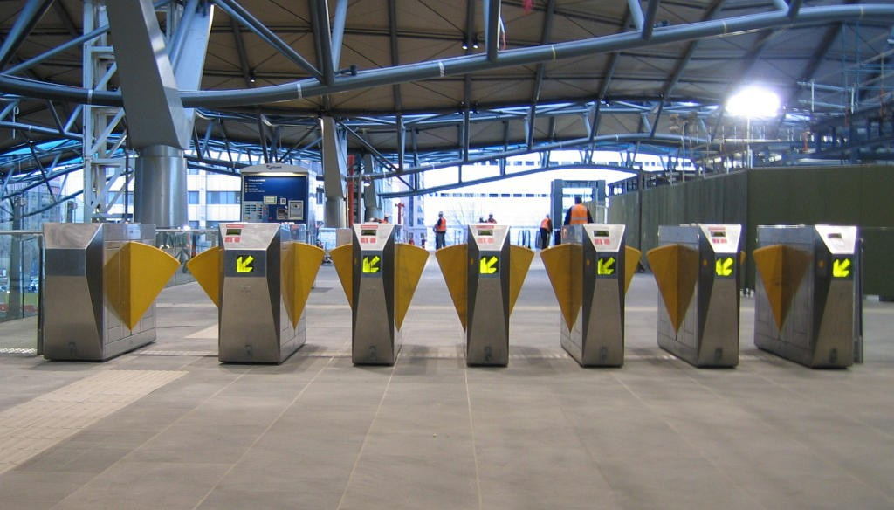
Principle of working

Slide 5
Touch In
Place the Tag in front of the NFC Device and connect
User balance is checked and if above a fixed threshold value access is granted
The NFC device transfers data to the central ticket server
The central ticket server issues the travel authorization

Slide 6
Touch Out
Mobile/Tag is tapped at destination NFC device
Appropriate balance is deducted
Exit is granted

Slide 7
Hardware and Software
NFC Device/Reader: made using arduino microcontroller and RFID module 13.56Mhz. This is kept at the entrance/exit to the station. This Device is programmed using Arduino integrated development environment
NFC tag : This tag is used by the user as a unique identification card
SERVER : All the users data is maintained in the central server to which the NFC device is connected. The server is programmed in the development environment called “processing”.
These hardware communicate with each other ,so that the user has proper access to the system.

Slide 8
Future Scope of the Project
The device Can be used at various industries, offices, institutes, Buses, etc to gain access to the place
Can be used for doing money transactions in the market.

Slide 9


Questions and Suggestions

